Slide 2
Project Director
Betsy Cohen

Slide 4
St. Louis County Executive
Charlie A. Dooley

Slide 6
St. Louis City Mayor
Francis G. Slay

Slide 8
St. Louis Mosaic Project
Regional Prosperity Through
Immigration & Innovation
@STLMosaic
STLMosaicProject.org

Slide 9
Steering Committee
Denny Coleman (co-chair)
St. Louis Economic Development Partnership
Rodney Crim (co-chair)
St. Louis Economic Development Partnership
Joe Reagan (co-chair)
St. Louis Regional Chamber
Batya Abramson-Goldstein
Interfaith Partnership Cabinet (JCRC)
James H. Buford
Civic Volunteer
Anna Crosslin
International Institute of St. Louis
Bob Fox
Casa de Salud
Dr. Joel Glassman
University of Missouri-St. Louis
Anthony Gonzalez-Angel
Gonzales Companies, LLC
Melissa Harper
Monsanto Company
Ellen Harshman
St. Louis University
Michael Holmes
Rx Outreach
Dr. Edward S. Macias
Washington University in St. Louis
John Nations
Metro Bi-State
Kathy Osborn
Regional Business Council
Patricia Ovca
Danforth Plant Science Center
Jim Pennekamp
University Park SIUE, Inc
Doug Rau
Sigma-Aldrich Corporation
Kathleen Ratcliffe
St. Louis CVC
Dr. Julian Schuster
Webster University
Peter Tao
TAO+LEE
Advisors
Tom Irwin
Civic Progress
Dee Joyner
Commerce Bank
Vince Schoemehl
Grand Center, Inc.
Tim Nowak
World Trade Center St. Louis
Betsy Cohen, Project Director

Slide 10
Background
November 2011
Identified as Strategic Priority
January 2012
Received William T Kemper Foundation study funds
June 2012
Economic Impact of Immigration on St. Louis study
Goal:
Fastest Growing U.S. Metro for Foreign Born

Slide 11
2012 Study: St. Louis Under 5%
1980
10th largest city
2012
19th largest metro
St. Louis has the lowest immigration share of a top 20 metro,
and 2nd slowest population growth.
1970
26th in # of foreign born
2012
43rd in # of foreign born
Other metros in the top 20 averaged 40% faster economic growth over the past decade.
Notes:
Removed:
The region’s relative scarcity of immigrants largely explains our demographic profile.
Very strong relationship between inflows of Foreign Born and increases in population.

Slide 12
Key Findings: 2012 Report
St. Louis foreign-born community is highly educated with predominantly white collar jobs.
60%
44%
more likely to be entrepreneurs
more likely to have at least a college education
Earns 25% more than average American born.
130%
3x
more likely to have an advanced degree
more likely to be high-skilled
Source: Jack Strauss PhD, Saint Louis University

Slide 13
How to Jumpstart Growth
June 2013
St. Louis Immigration Recommendations
Internal gap analysis and external best practices assessment
By: Dr. Jack Strauss, Saint Louis University
Mark Tranel, University of Missouri, St. Louis
Jeremy Caddel, Washington University in St. Louis

Slide 14
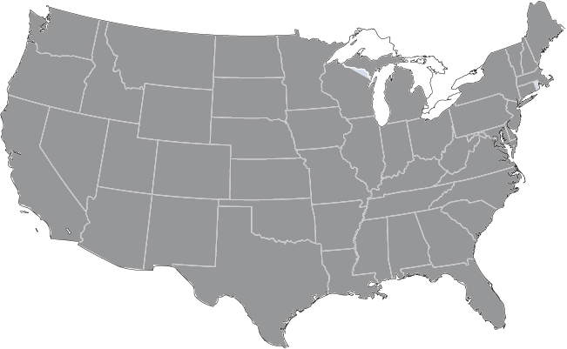
Key Findings: 2013 Study
Fractionalized local services
Region does not provide coordinated services
Business and international communities not fully linked
Immigrants and religious organizations not fully linked
St. Louis region compared to:
Kansas City
Detroit
Nashville
Louisville
Dayton
Cincinnati
Cleveland
Pittsburgh
Baltimore
Indianapolis

Slide 15
Rate of Foreign Born Growth (2006-2012, ACS)
6th
fastest growth rate

Slide 16
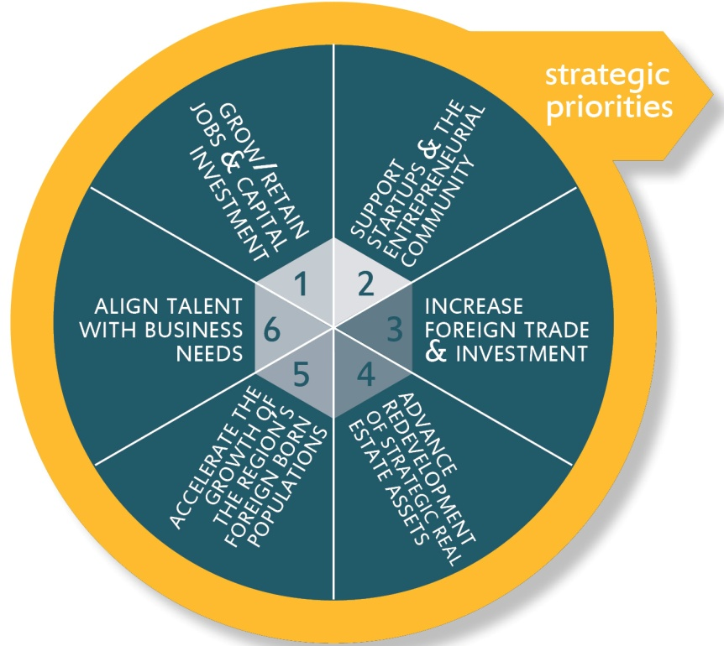
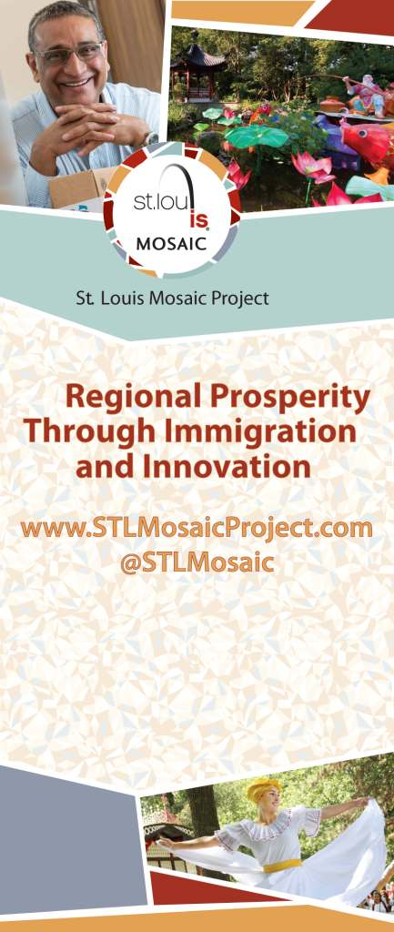
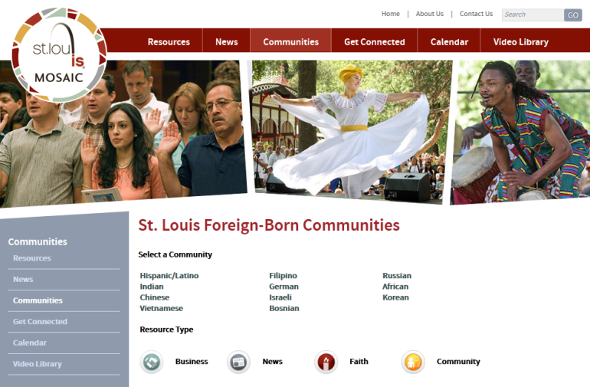
Year 1
Launch a welcome center
Coordination,
Communication,
Assessment
Create online ethnic communities

Slide 17
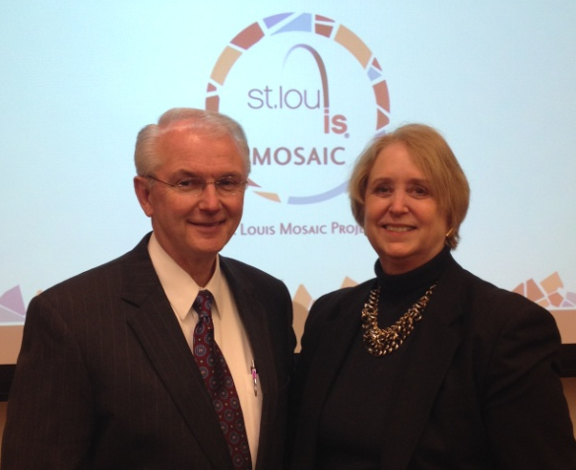
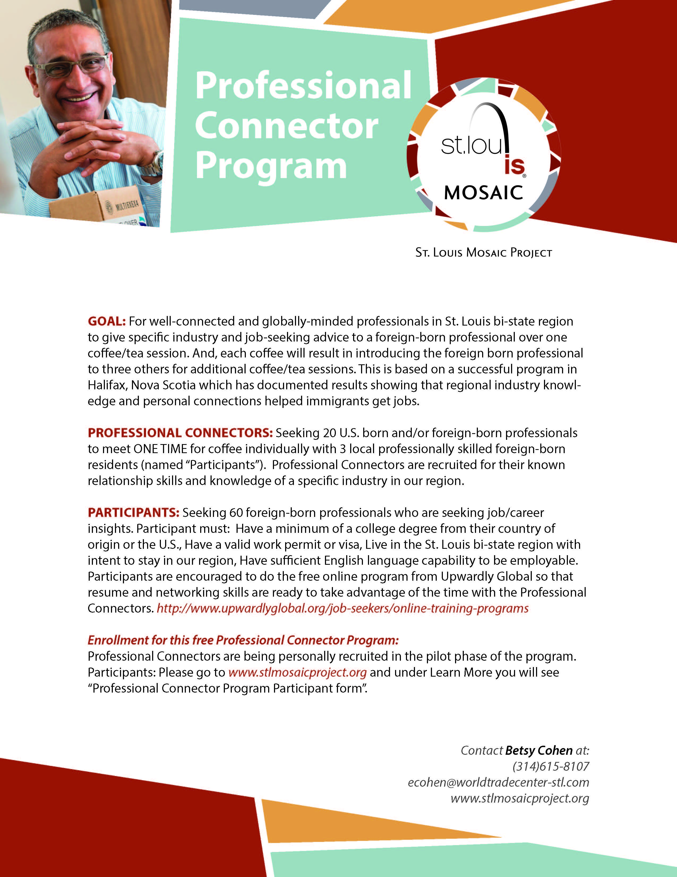
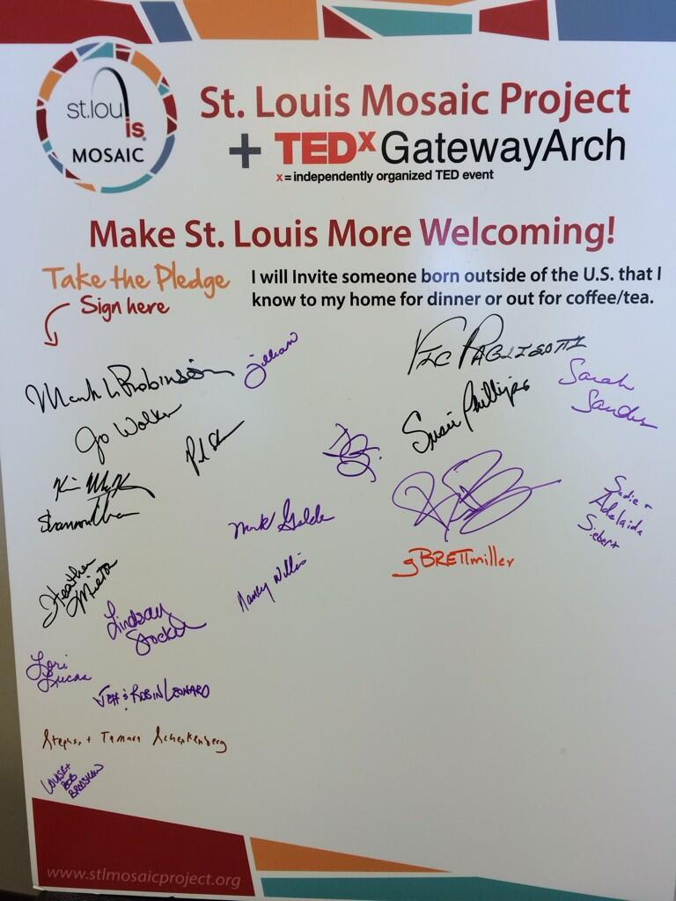
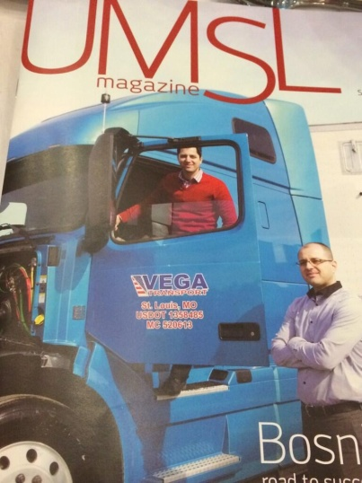
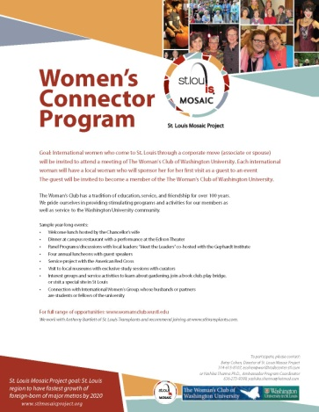
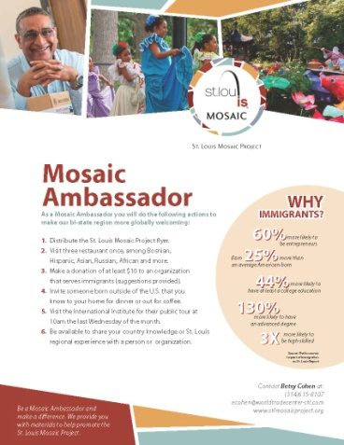
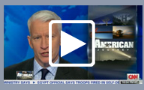
Year 1
Engage business community
Connect to local community
Promote policies through political leadership

Slide 18
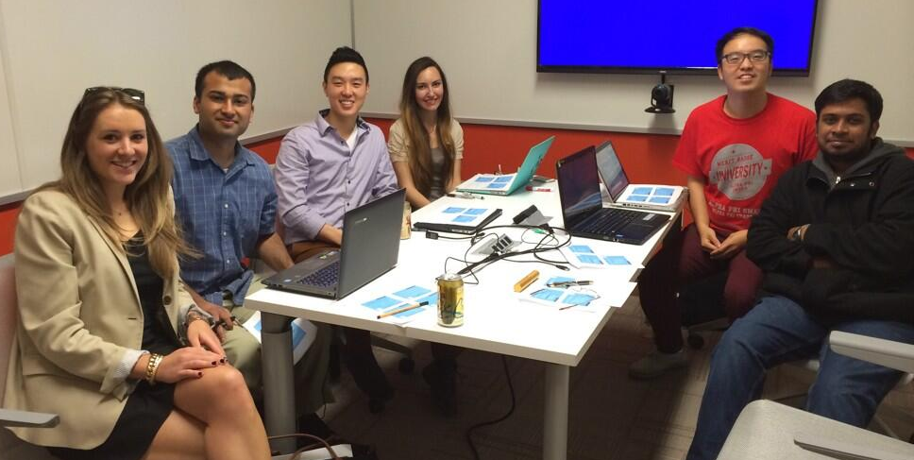


Year 1
Include international students
Communicate with MO, IL and U.S. legislatures
Welcome new ideas

Slide 19
What’s next?
Immigrant entrepreneurship program
International student/corporate program
Engineering career path plan
Health care career path plan

Slide 20
Immigration Reform: Committee Principles
Economic imperative for St. Louis
System must be streamlined and visa availability expanded
Border security and rule of law
Special initiatives to welcome and integrate new citizens

Slide 21
Regional Prosperity Through
Immigration & Innovation
www.STLMosaicProject.org
@STLMosaic

Slide 22
Todd Schulte
FWD.us

Slide 24
Robert’s slide deck

