Slide 1
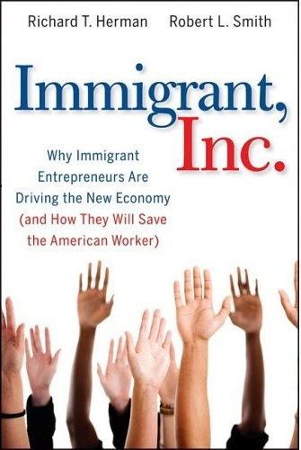
Immigrant, Inc. Building an Ecosystem to Support & Attract Immigrant Entrepreneurs
Richard Herman
June 26, 2014
St. Louis Mosaic Project

Slide 3
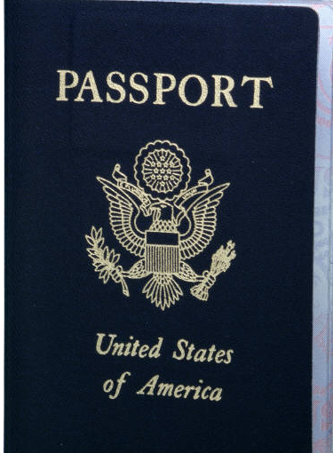
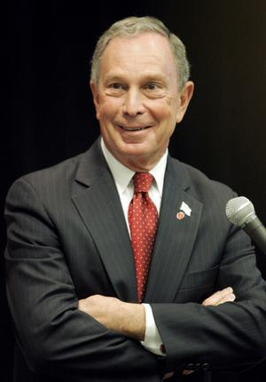

Slide 4
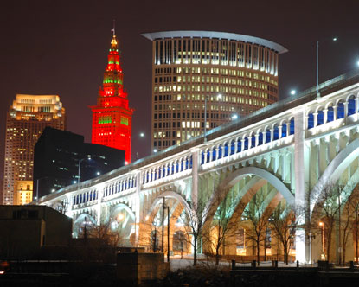

Slide 5
Rust Belt Is Hemorrhaging Jobs & People
MICHIGAN
Over last 10 years, lost
790,000 jobs
Detroit: over last 60 years, lost 50% of population (1.8 million to 900,000)
Percentage of immigrants dropped from 30% to 10%
OHIO
Over last 10 years, lost 525,000 jobs
Cleveland: over last 60 years, lost 60% of population (950,000 to 396,000) (17% in 10 yrs)
Percentage of immigrants dropped from 30% to 5%

Slide 6
Source: U.S. Conference of Mayors Metro Economies Report 2013
Source: U.S. Census Bureau

Slide 7
Source: U.S. Conference of Mayors Metro Economies Report 2013
Source: U.S. Census Bureau

Slide 8
The Shrinking Pie
“Rust Belt” cities must act now. Population loss, a declining tax base, and an exodus of companies dictate a new paradigm The “Us vs Them” model is not sustainable.

Slide 9
New Strategies and Thinking:
Leveraging Diverse Talent for Growth

Slide 10
“Growing the Pie”
SmartInclusion
Regional and business growth depend upon population growth. Business (micro) and regional (macro) strategies are inextricably linked.

Slide 11
New Talent Strategies
Smart Inclusion
Smart Region
New Inclusion Model
Immigrant Ecosystem
Measurable Success
Communication Planning

Slide 12
“IMMIGRANT, INC” ---- A CULTURE
Family
Education
Entrepreneurship
Self-Reliance
Thrift
Love of Country & the Dream

Slide 13
….Isn’t “Immigrant”
a Dirty Word?

Slide 14
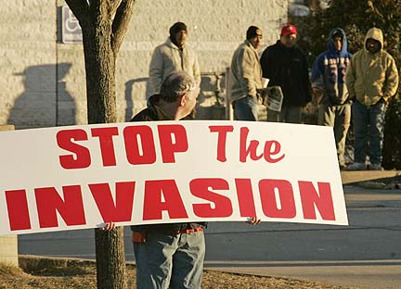

Slide 19
Immigration and Crime FACTS
San Diego, Phoenix, El Paso, and Austin
Immigrant Incarceration Rates are one-fifth the incarceration rates of people born in the U.S.
Notes:
LOOK AT THE FACTS:
According to the Associated Press report in June 2010 “The top four big cities in America with the lowest rates of violent crime are all in border states: San Diego, Phoenix, El Paso and Austin, according to a new FBI report. And an in-house Customs and Border Protection report shows that Border Patrol agents face far less danger than street cops in most U.S. cities.”
Immigrant incarceration rates are 20% of non-immigrant rates, a robust statistic that holds up even after naturalization.
WELL, LET’S LOOK AT SOME MORE FACTS UNCOVERED IN THE GLOBAL DETROIT REPORT

Slide 20
We don’t talk about immigrants as the Dream-Keepers, the Job-Creators, the Bedrock of Family-Values, the ENGINE that makes America work!

Slide 21
“The richest regions are those with the highest proportion of immigrants.” President’s Commission on Immigration, 1953

Slide 22
Where do jobs come from?

Slide 23
STARTUPS: New employment paradigm
ALL net job creation in America over last 25 years comes from STARTUPS --- creating 40 million new jobs
New Firms add an average of 3 million jobs in first year
Older companies lost 1 million jobs annually
--- Kauffman Foundation

Slide 24
When it comes to job growth, STARTUP companies aren’t everything……..
they’re the ONLY THING!

Slide 25
So WHO are behind the startups in America?

Slide 26
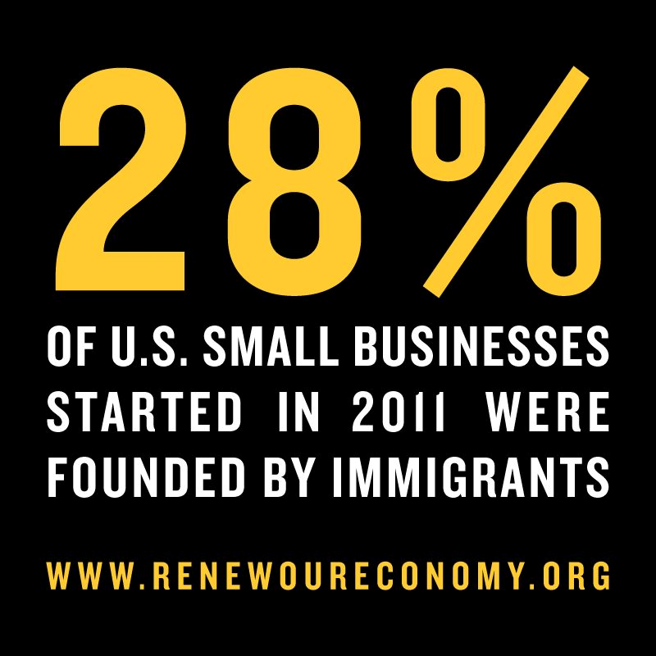

Slide 27
Immigrants Driving New Economy & Urban Revitalization
* Immigrants twice as likely as native-born
to start a business;
* Immigrants founded more than 50% of the high-tech companies in Silicon Valley;
* Immigrants are more likely to earn an advanced degree, invent something, and be awarded a U.S. patent;

Slide 28
Immigrants Are Driving U.S. Innovation
* Immigrants filing patents at twice rate of American-
born.
* Immigrant patent filings: 72% Qualcomm, 65% Merck,
64% GE, 60% Cisco

Slide 29
Immigrant-Founded Companies
Compiled by Richard Herman, www.ImmigrantInc.com

Slide 30
Immigrants Start Companies & Create Jobs
*40% of Fortune 500 companies were founded by an immigrant or child of an immigrant
*These companies employ 10 million people worldwide, and generate $4,200,000,000,000 in revenue per year
2011 study by Partnership for a New American Economy

Slide 31
7 of 10 most valuable brands in the world were created by U.S. immigrants or children of U.S. immigrants
Ford Google Intel
GE Budweiser Home Depot
AT&T McDonald’s U.S. Steel
Boeing IBM Dow
Disney Kraft UPS
Apple Procter & Gamble Estee Lauder
Hertz Levi’s DuPont
Pfizer Bank of America Heinz

Slide 32
Latino-Owned Business in USA
2.8 Million Businesses
$400 Billion in Annual Revenue
$65 Billion in Payroll
2.2 Million Employees

Slide 33
we welcome the job-creators

Slide 34
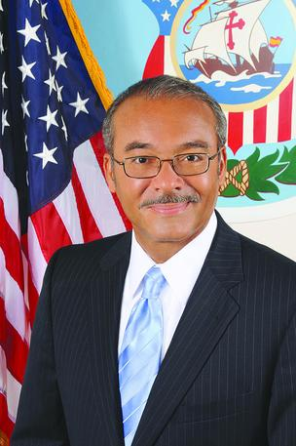
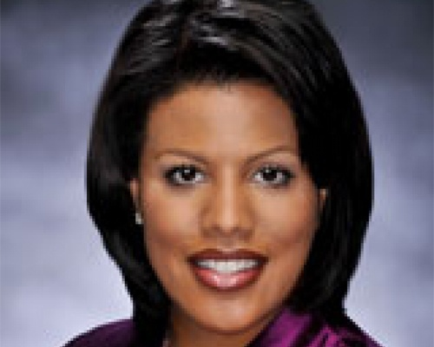
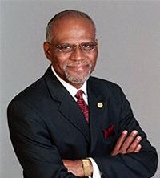
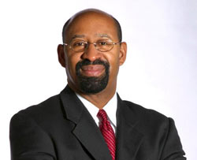
A New Urban Movement: Welcoming Immigrants to Spur Economic Growth
Columbus
Baltimore
St. Louis
Global Philly
Notes:
Here is our mission:
Immigrants and economic development

Slide 35
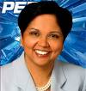
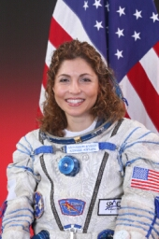
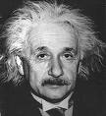
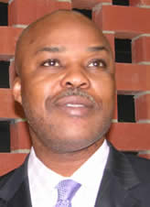
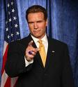
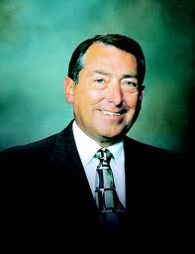
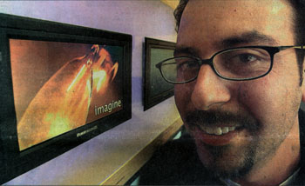
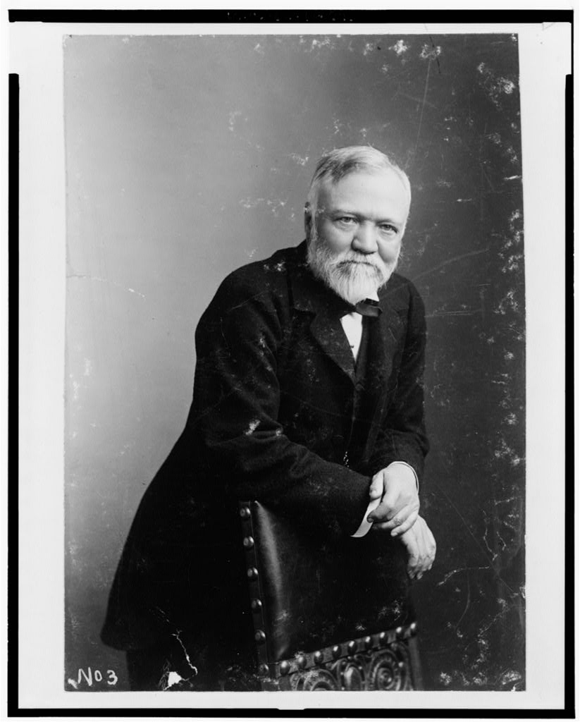

Slide 36
“To immigrate is an entrepreneurial act”
--Ed Roberts, Founder
MIT Entrepreneurship Center

Slide 37
Missouri Immigrant Entrepreneurs & Consumers: The Facts
*9,800 Asian owned businesses had sales of $3.7 billion, and employed 25,300 people
*6,200 Latino owned businesses had sales of $1.4 billion and employed 9,500 people
* Annual Purchasing power of Missouri’s Latino & Asian population totaled $10.0 billion (increasing 600% since 1990)

Slide 38
Foreign Students in Missouri National Rank and Economic Impact
 | Rank in US | Total
Foreign Students in Missouri | #12 | 17,279 70% increase over 5 years
Estimated Foreign Students Expenditure in Missouri (in millions of dollars) |  | $452 Nearly 2X in 5 yr
Percent of Foreign Student’s in STEM Fields of Study: 35%
Percent of U.S. Undergraduate Student’s in STEM Fields of Study: 14%
Missouri Institutions with Foreign Students
Institution | City | Total
Wash University in St. Louis | St. Louis | 2235
St. Louis University -Main | St. Louis | 1080
University of Missouri | Columbia | 2490
Missouri State University | Springfield | 1482

Slide 39
Intl Students Who Stay = Jobs for U.S.
For every 100 international students who stay after earning U.S. advanced degrees in science, technology, engineering or math a CREATE 262 JOBS IN AMERICA
2011 Study by American Enterprise Institute & Partnership for New American Economy:

Slide 40
Immigrants Can Drive Exports
Research in Sweden demonstrates that a 10 percent increase in immigrant population was linked to a 6 percent increase in bilateral trade with the immigrants’ home country.

Slide 41
10% of Fortune 100 CEOs Are Immigrants
Despite coming from demographic that comprises 1.5% of U.S. population

Slide 42
$1.5 trillion added to GDP in next 10 years
….If we legalize the 11 million undocumented persons in U.S.
Study at UCLA, 2010

Slide 44
And not just PhD international students ----- all hard- working immigrants
with a dream.
It’s all connected.

Slide 45
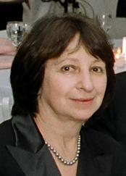
REFUGEES CAN CHANGE THE WORLD

Slide 46
Millions of Unfilled Jobs in the Great Recession
3.6 million open jobs according to U.S. Dept. of Labor

Slide 47
Immigrants largely compliment, not displace, American-born workforce.
Immigrant workers usually work in high-skilled or lower skilled jobs, where U.S. has a shortage of workers.

Slide 48
How About Undocumented Workers & Lower Skilled Jobs?
*Undocumented Workers Negatively Impact U.S. Worker Wages by 0.15 % ---less than 2/10 of of 1%
U.S. Federal Reserve Bank, Atlanta
*Each Lower-Skilled, Non-Ag Worker in Shortage Occupation creates 4.6 American Jobs.
Partnership New American Economy

Slide 50
Conversation on Immigration & Immigrants: BROKEN

Slide 51
This is what NYC Mayor Bloomberg calls:
“National Suicide.”

Slide 52
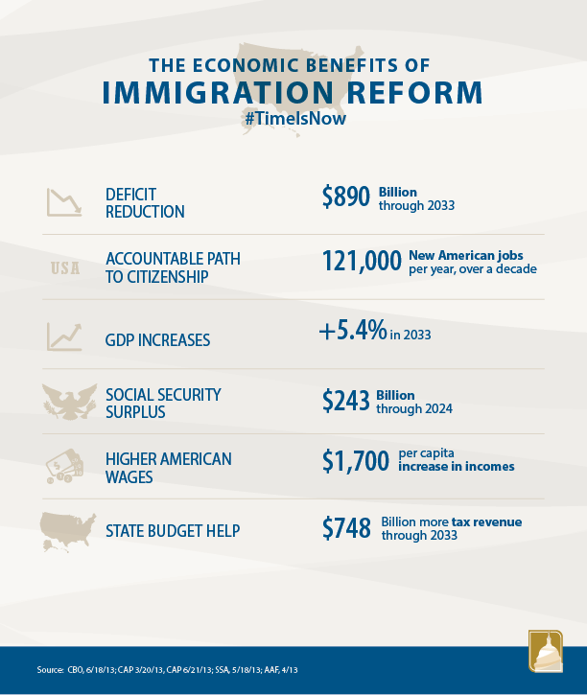

Slide 53
It’s important that we understand WHY so many Americans have anxiety over new immigrants

Slide 54
America’s Demographics re A-Changin’
* Last decade, 85% of population increase from racial & ethnic minorities
* 1 out of 7 new marriages are
interracial

Slide 55
* Young whites (under 18) are the minority in 10 states, including Arizona
* By 2021, the majority of
children 4 and under will be
minority
* By 2042, the majority of all
Americans will be minority

Slide 57
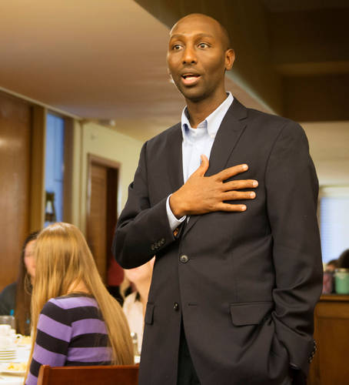

Slide 59
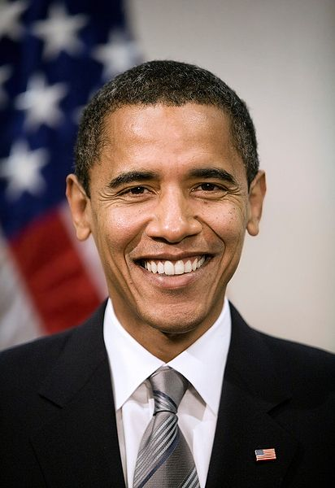

Slide 60
it’s all connected

Slide 61
Nearly 2/3 of America is an immigrant, a child or grandchild of an immigrant, or married to an immigrant

Slide 62
We Are All Immigrants

Slide 63
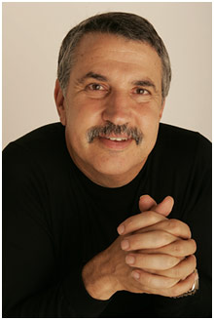
“World Is Flat” Guy, Tom Friedman
“Pour into the America the most diverse, smart and energetic immigrants from every corner of the world and the stir and repeat, stir and repeat, stir and repeat.”

Slide 64
Want to Win? Build the most powerful teams on the planet
(just like NBA, MLB, NHL)

Slide 65
Talent is the New Oil. Drill, Baby, Drill!

Slide 66
Welcome to the New America

Slide 67
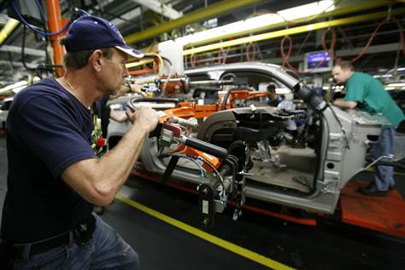
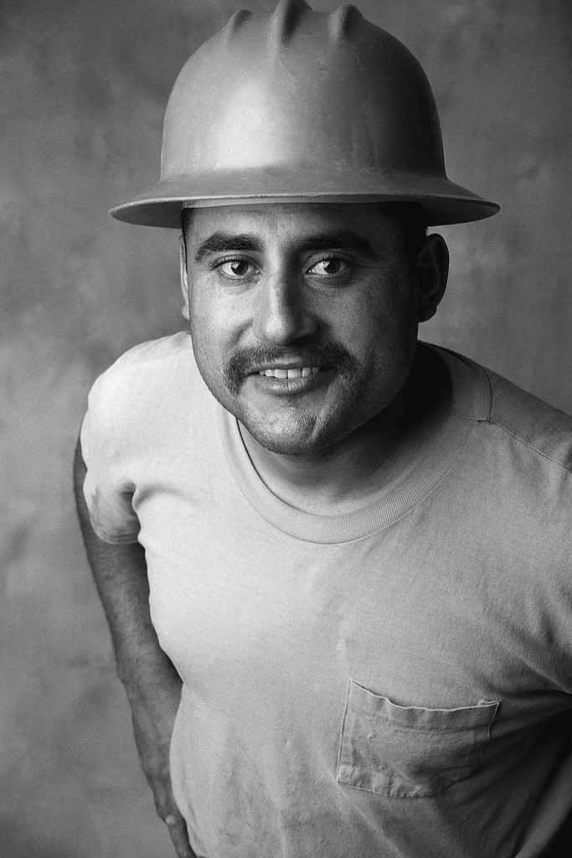
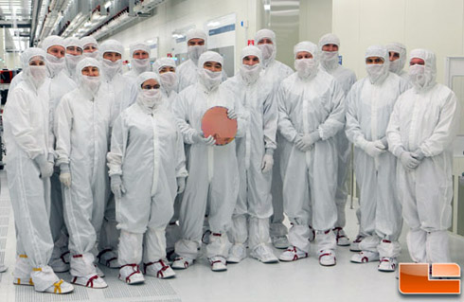
Personalize communication to all stakeholders. Everyone must understand how they add value to an international human capital strategy.

Slide 68
What Does the New Economy Crave?
HYPER-CONNECTIVITY

Slide 69
Cleveland
Silicon Valley

Slide 70
SmartInclusion

Slide 71
What Immigrant Entrepreneurs
Need to be Successful in the United States?
(what can we do to help grow & attract?)

Slide 72
Network, Encouragement, Validation

Slide 73
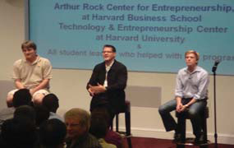
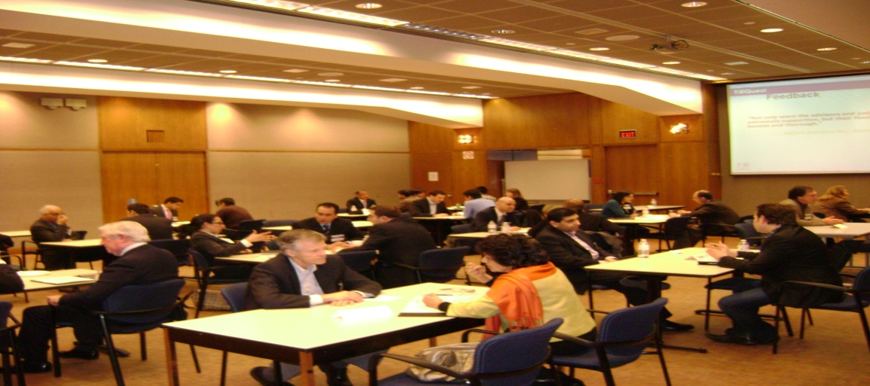
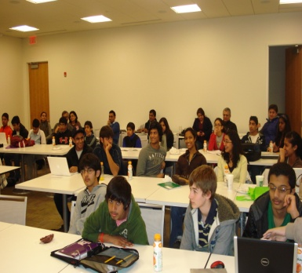
World’s Largest Non Profit
Fostering Entrepreneurship
EDUCATING MENTORING NETWORKING
Scaling to Next Level
October 12 2010
Kansas City
Silicon Valley
Tokyo
Dubai
Singapore
Mauritius
Melbourne
Extending Global Footprint

Slide 74
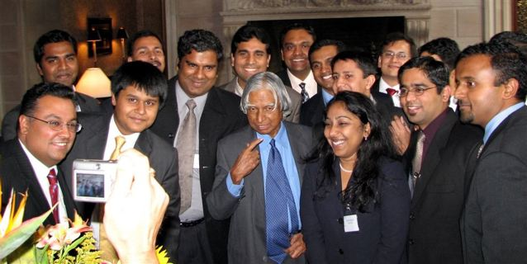
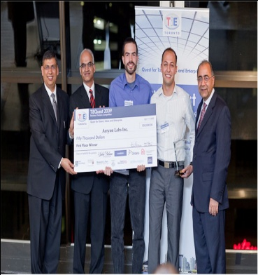
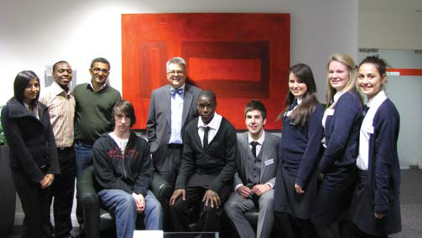
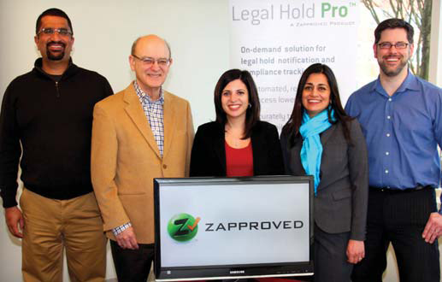
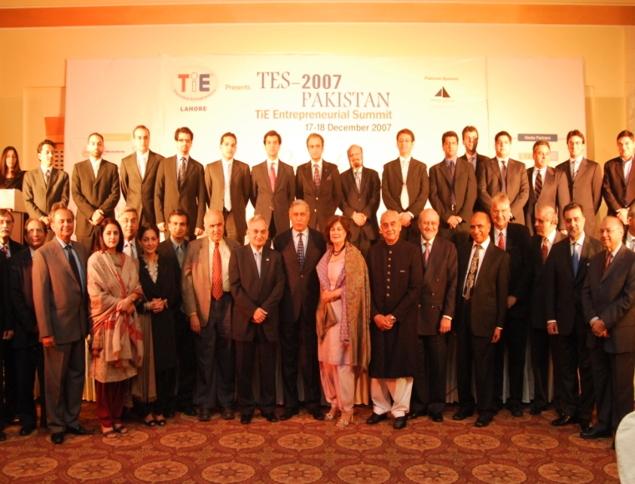
Join the TiE Network
Empower Next Generation Entrepreneurs

Slide 75
Immigrant & Minority Entrepreneur Incubator
Centralized Location for Business Assistance, Training, Networking
Branding as “Start-Up City” for ALL entrepreneurs
New Cross-Cultural Business Partnerships (American-born & foreign-born

Slide 76
Foreign-Business Expansion Center
Leveraging Entrepreneur’s U.S. immigration Goals Via Access to Visas & Green Cards
EB-5
E-2
L-1
H-1B
Chinese-Friendly City

Slide 77
Intl Human Capital Strategies for local corporations
OPT
H-1B
Diversity/HR/Legal
Recruitment

Slide 78
Research Institute for Immigrant Entrepreneurship

Slide 79
Immigrant Entrepreneurship Financing

Slide 80
Why Pubic Engagement and Communication Planning are Important to Immigrant Entrepreneurs

Slide 81
And most of all……..have FUN connecting to different cultures & harvesting the fruits of the global economy ☺

Slide 83
7 Steps to “thinking like an immigrant”
1.) Explore the world. Become a “Marco Polo.” (get out of your comfort zone)

Slide 84
7 Steps to “thinking like an immigrant
2.) Education. Take more classes! Regardless of your age or stage in life, never forget that your “inner immigrant” craves life-long education and reveres education as an asset than can never be taken away from you.

Slide 85
7 Steps to “thinking like an immigrant
3.) Honor Parents’ Sacrifice. “Honor thy father and thy mother.” Honor their sacrifice with every step you take toward your dream. Leverage this motivation --- fulfill your moral duty to achieve success.

Slide 86
7 Steps to “thinking like an immigrant
4.) Collaborate & Team-Up. Find the best partners. You can’t do it alone. Find the very best partner (often this will be an immigrant) and team-up. Look to groups like HBA, TiE, HYSTA, NSHMBA, Techwadi.

Slide 87
7 Steps to “thinking like an immigrant
5.) Take Risk. Make some big bets in your business and professional career. Immigrant business success has a lot to do with high risk tolerance.

Slide 88
7 Steps to “thinking like an immigrant
6.) Embrace Desperation. Act like you have nothing to fall back on, and work like your life depends on it. Convince yourself that your savings account is empty, and that your daily work offers the only hope of survival. Eat what you kill!

Slide 89
7 Steps to “thinking like an immigrant
7.) Dream.
And dream BIG!

Slide 90
Good Luck

Slide 92
Contact Me
Richard Herman
Email: RichardtmHerman@gmail.com
Phone: 216-696-6170
Twitter: @ImmigrantInc
Facebook
Linkedin

